Slide 1
Introduction to Differential Equations - Lecture 10
Fei Qi
Email: fei.qi@du.edu
Office Hour: TBA
Website: https://feiqimath.github.io

Slide 2
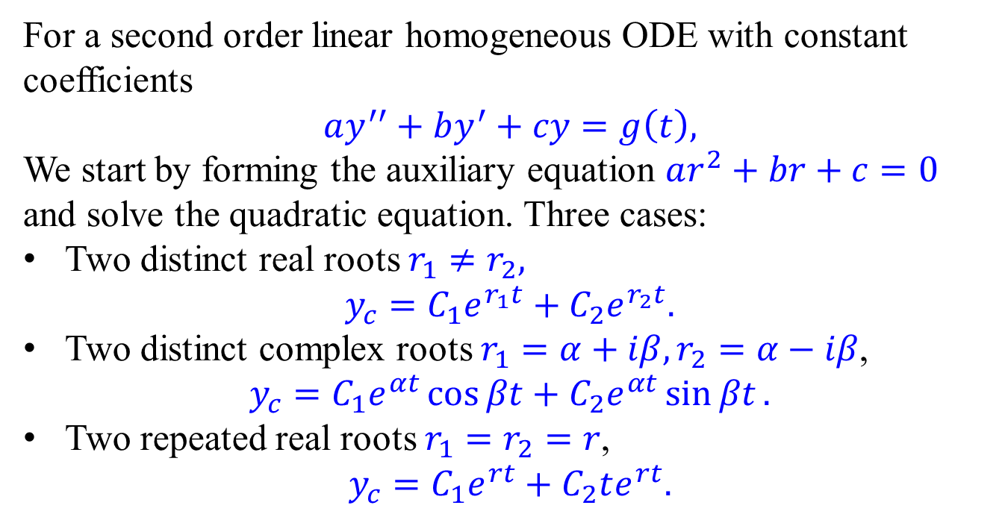
Summary of homogeneous ODE with const. coeff.
For a second order linear homogeneous ODE with constant coefficients
$$ay^{′′}+by^{′}+cy=g\left(t\right),$$
We start by forming the auxiliary equation $ar^{2}+br+c=0$ and solve the quadratic equation. Three cases:
Two distinct real roots $r_{1}≠r_{2},$
$$y_{c}=C_{1}e^{r_{1}t}+C_{2}e^{r_{2}t}.$$
Two distinct complex roots $r_{1}=α+iβ, r_{2}=α−iβ$, $y_{c}=C_{1}e^{αt}\cos{βt}+C_{2}e^{αt}\sin{βt}.$
Two repeated real roots $r_{1}=r_{2}=r$,
$$y_{c}=C_{1}e^{rt}+C_{2}te^{rt}.$$

Slide 3
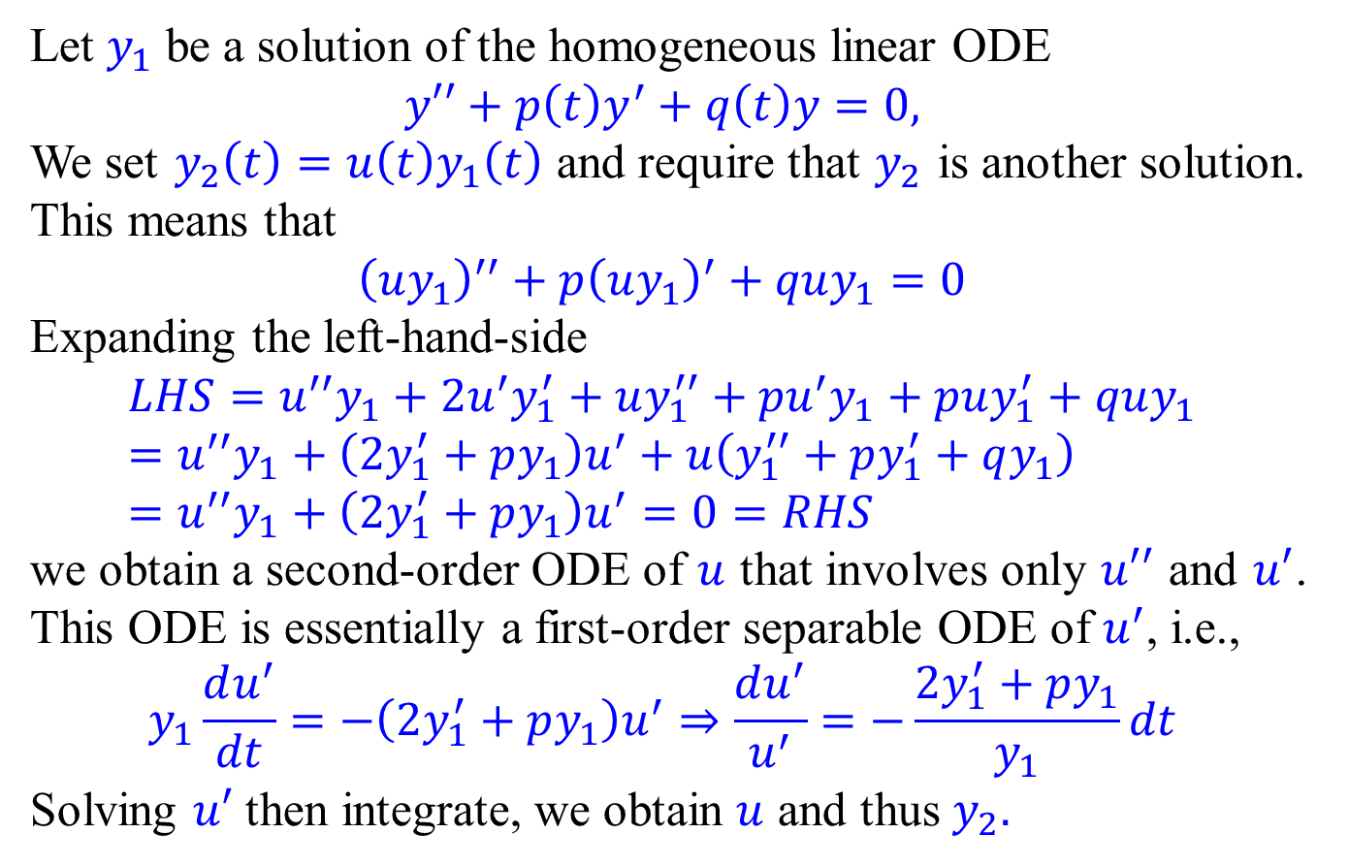
Reduction of order
Let $y_{1}$ be a solution of the homogeneous linear ODE
$$y′′+p\left(t\right)y^{′}+q\left(t\right)y=0,$$
We set $y_{2}\left(t\right)=u\left(t\right)y_{1}\left(t\right)$ and require that $y_{2}$ is another solution.
This means that
$${\left(uy_{1}\right)}^{′′}+p{\left(uy_{1}\right)}^{′}+quy_{1}=0$$
Expanding the left-hand-side
$$LHS=u^{′′}y_{1}+2u^{′}y_{1}^{′}+uy_{1}^{′′}+pu^{′}y_{1}+puy_{1}^{′}+quy_{1} \\ =u^{′′}y_{1}+\left(2y_{1}^{′}+py_{1}\right)u^{′}+u\left(y_{1}^{′′}+py_{1}^{′}+qy_{1}\right) \\ =u^{′′}y_{1}+\left(2y_{1}^{′}+py_{1}\right)u^{′}=0=RHS$$
we obtain a second-order ODE of $u$ that involves only $u′′$ and $u′$. This ODE is essentially a first-order separable ODE of $u^{′}$, i.e.,
$$y_{1}\frac{du^{′}}{dt}=−\left(2y_{1}^{′}+py_{1}\right)u^{′}⇒\frac{du^{′}}{u^{′}}=−\frac{2y_{1}^{′}+py_{1}}{y_{1}}dt$$
Solving $u′$ then integrate, we obtain $u$ and thus $y_{2}.$

Slide 4
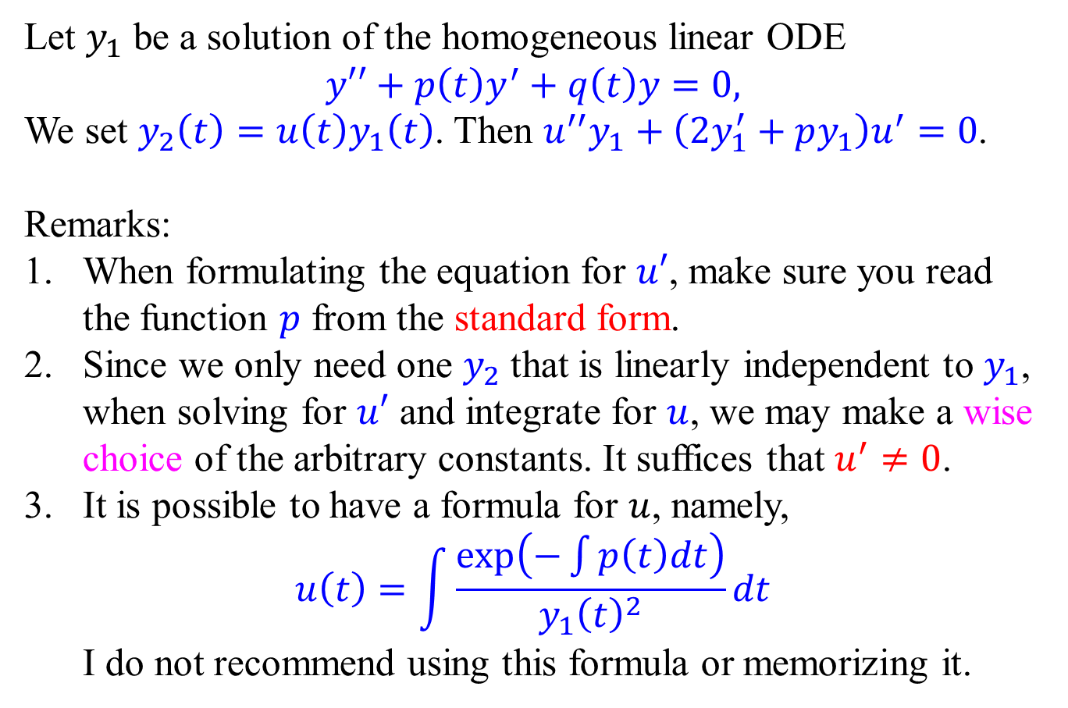
Reduction of order
Let $y_{1}$ be a solution of the homogeneous linear ODE
$$y′′+p\left(t\right)y^{′}+q\left(t\right)y=0,$$
We set $y_{2}\left(t\right)=u\left(t\right)y_{1}\left(t\right)$. Then $u^{′′}y_{1}+\left(2y_{1}^{′}+py_{1}\right)u^{′}=0$.
Remarks:
When formulating the equation for $u′$, make sure you read the function $p$ from the standard form.
Since we only need one $y_{2}$ that is linearly independent to $y_{1}$, when solving for $u′$ and integrate for $u$, we may make a wise choice of the arbitrary constants. It suffices that $u^{′}≠0$.
It is possible to have a formula for $u$, namely, $u\left(t\right)=\int{\frac{\exp\left(−\int{p\left(t\right)dt}\right)}{y_{1}{\left(t\right)}^{2}}dt}$ I do not recommend using this formula or memorizing it.

Slide 5
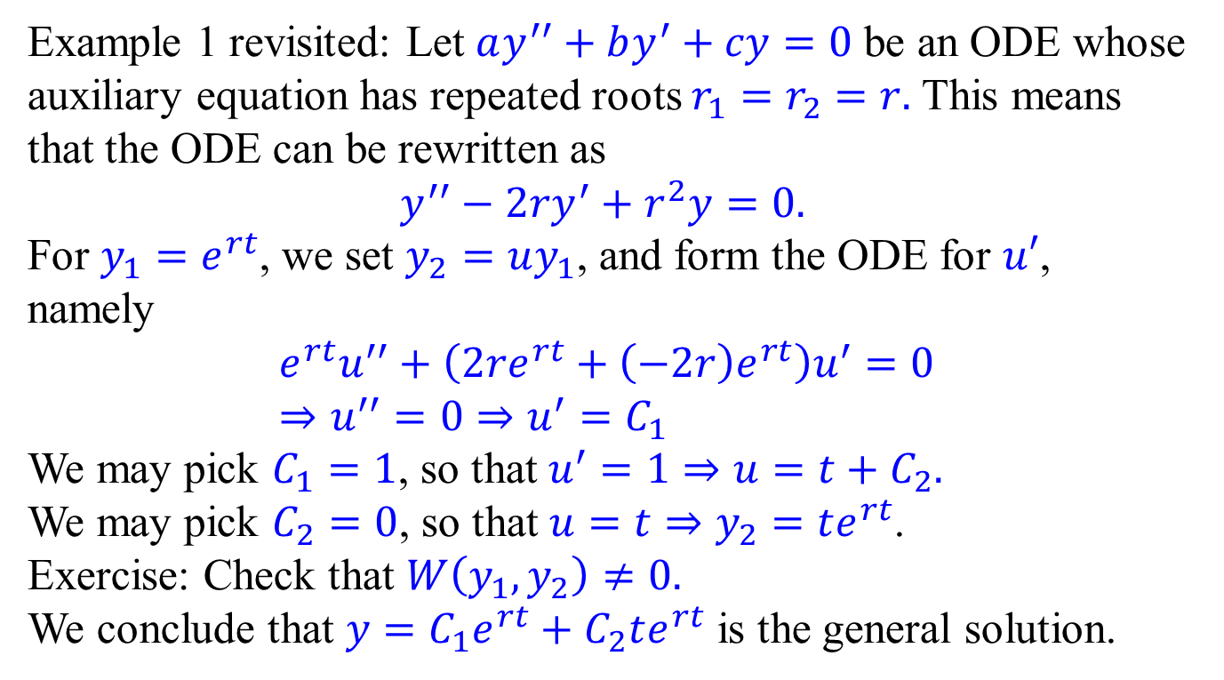
Reduction of order - Examples
Example 1 revisited: Let $ay^{′′}+by^{′}+cy=0$ be an ODE whose auxiliary equation has repeated roots $r_{1}=r_{2}=r.$ This means that the ODE can be rewritten as
$$y^{′′}−2ry^{′}+r^{2}y=0.$$
For $y_{1}=e^{rt}$, we set $y_{2}=uy_{1}$, and form the ODE for $u′$, namely
$$e^{rt}u^{′′}+\left(2re^{rt}+\left(−2r\right)e^{rt}\right)u^{′}=0 \\ ⇒u^{′′}=0⇒u^{′}=C_{1}$$
We may pick $C_{1}=1$, so that $u^{′}=1⇒u=t+C_{2}.$
We may pick $C_{2}=0$, so that $u=t⇒y_{2}=te^{rt}$.
Exercise: Check that $W\left(y_{1},y_{2}\right)≠0.$
We conclude that $y=C_{1}e^{rt}+C_{2}te^{rt}$ is the general solution.

Slide 6
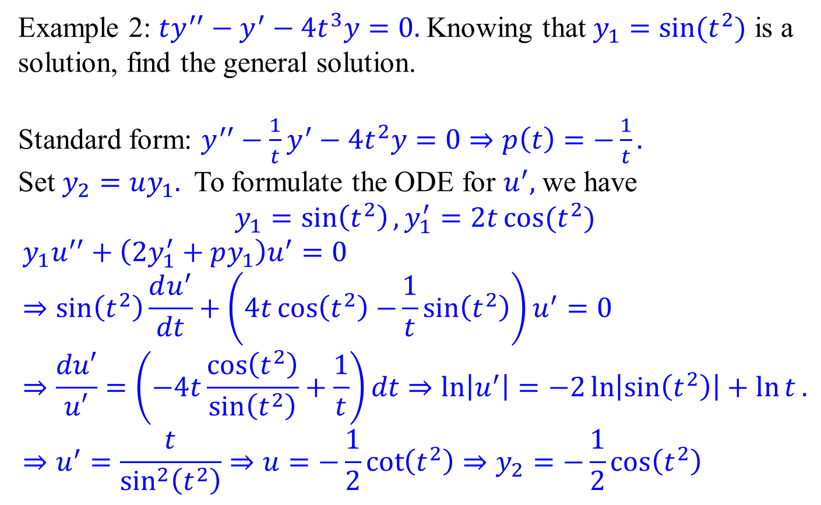
Reduction of order - Examples
Example 2: $ty^{′′}−y^{′}−4t^{3}y=0.$Knowing that $y_{1}=sin⁡(t^{2})$ is a solution, find the general solution.
Standard form: $y^{′′}−\frac{1}{t}y^{′}−4t^{2}y=0⇒p\left(t\right)=−\frac{1}{t}.$
Set $y_{2}=uy_{1}.$ To formulate the ODE for $u^{′},$ we have $$y_{1}=\sin\left(t^{2}\right),y_{1}^{′}=2t\cos{{(t}^{2})}$$
$$y_{1}u^{′′}+\left(2y_{1}^{′}+py_{1}\right)u^{′}=0⇒\sin\left(t^{2}\right)\frac{du^{′}}{dt}+\left(4t\cos\left(t^{2}\right)−\frac{1}{t}\sin\left(t^{2}\right)\right)u^{′}=0 \\ ⇒\frac{du′}{u′}=\left(−4t\frac{\cos\left(t^{2}\right)}{\sin\left(t^{2}\right)}+\frac{1}{t}\right)dt⇒\ln\left|u^{′}\right|=−2\ln\left|\sin\left(t^{2}\right)\right|+\ln{t}. \\ ⇒u^{′}=\frac{t}{\sin^{2}\left(t^{2}\right)}⇒u=−\frac{1}{2}\cot\left(t^{2}\right)⇒y_{2}=−\frac{1}{2}\cos\left(t^{2}\right)$$

Slide 7
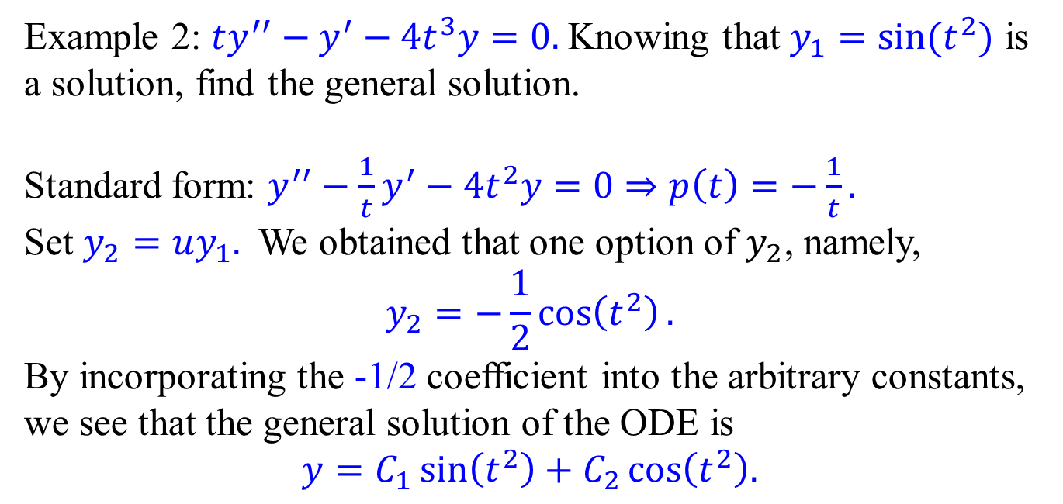
Reduction of order - Examples
Example 2: $ty^{′′}−y^{′}−4t^{3}y=0.$Knowing that $y_{1}=sin⁡(t^{2})$ is a solution, find the general solution.
Standard form: $y^{′′}−\frac{1}{t}y^{′}−4t^{2}y=0⇒p\left(t\right)=−\frac{1}{t}.$
Set $y_{2}=uy_{1}.$ We obtained that one option of $y_{2}$, namely,
$$y_{2}=−\frac{1}{2}\cos\left(t^{2}\right).$$
By incorporating the -1/2 coefficient into the arbitrary constants, we see that the general solution of the ODE is
$$y=C_{1}\sin\left(t^{2}\right)+C_{2}\cos\left(t^{2}\right).$$

Slide 8
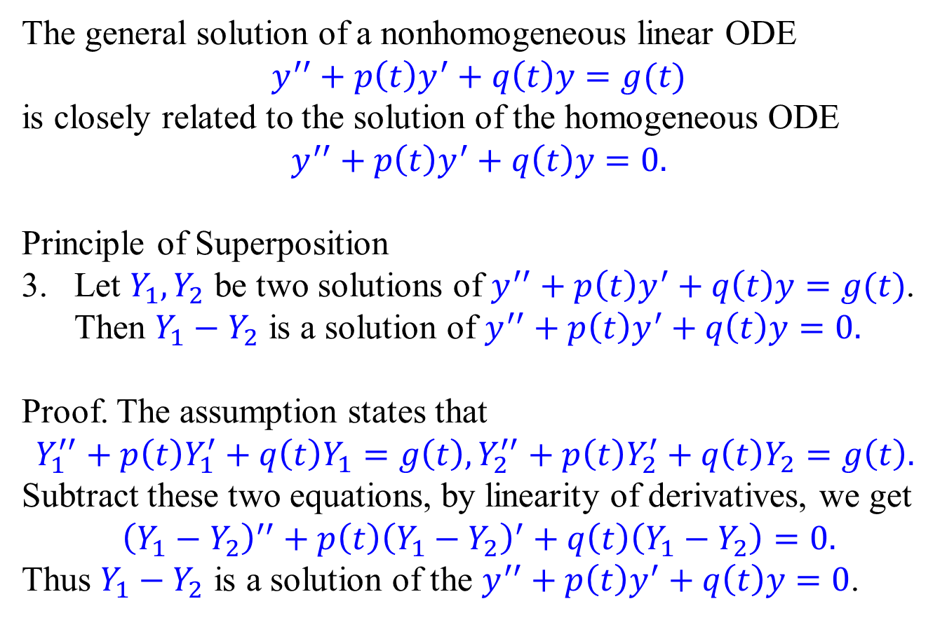
Nonhomogeneous ODE and Superposition
The general solution of a nonhomogeneous linear ODE
$$y^{′′}+p\left(t\right)y^{′}+q\left(t\right)y=g(t)$$
is closely related to the solution of the homogeneous ODE $$y^{′′}+p\left(t\right)y^{′}+q\left(t\right)y=0.$$
Principle of Superposition
Let $Y_{1},Y_{2}$ be two solutions of $y^{′′}+p\left(t\right)y^{′}+q\left(t\right)y=g(t)$. Then $Y_{1}−Y_{2}$ is a solution of $y^{′′}+p\left(t\right)y^{′}+q\left(t\right)y=0.$
Proof. The assumption states that
$$Y_{1}^{′′}+p\left(t\right)Y_{1}^{′}+q\left(t\right)Y_{1}=g\left(t\right), Y_{2}^{′′}+p\left(t\right)Y_{2}^{′}+q\left(t\right)Y_{2}=g\left(t\right).$$
Subtract these two equations, by linearity of derivatives, we get
$${\left(Y_{1}−Y_{2}\right)}^{′′}+p\left(t\right){\left(Y_{1}−Y_{2}\right)}^{′}+q\left(t\right)\left(Y_{1}−Y_{2}\right)=0.$$
Thus $Y_{1}−Y_{2}$ is a solution of the $y^{′′}+p\left(t\right)y^{′}+q\left(t\right)y=0$.

Slide 9
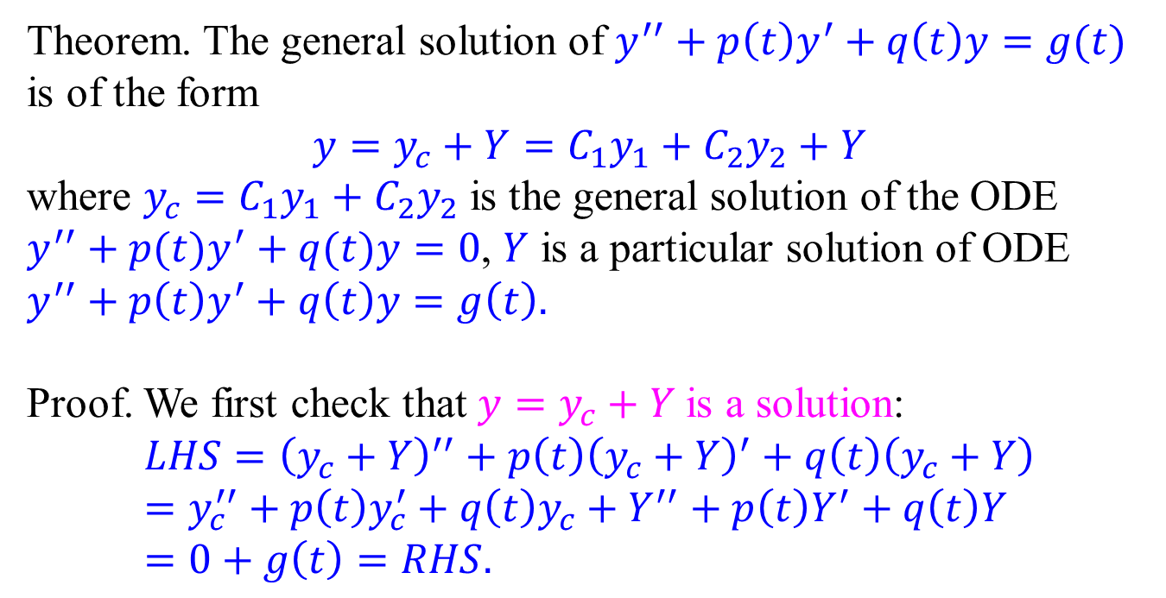
Structure theorem of the general solution
Theorem. The general solution of $y^{′′}+p\left(t\right)y^{′}+q\left(t\right)y=g(t)$ is of the form $$y=y_{c}+Y=C_{1}y_{1}+C_{2}y_{2}+Y$$
where $y_{c}=C_{1}y_{1}+C_{2}y_{2}$ is the general solution of the ODE $y^{′′}+p(t)y^{′}+q(t)y=0$, $Y$ is a particular solution of ODE $y^{′′}+p\left(t\right)y^{′}+q\left(t\right)y=g\left(t\right).$
Proof. We first check that $y=y_{c}+Y$ is a solution:
$$LHS={\left(y_{c}+Y\right)}^{′′}+p\left(t\right){\left(y_{c}+Y\right)}^{′}+q\left(t\right)\left(y_{c}+Y\right) \\ =y_{c}^{′′}+p\left(t\right)y_{c}^{′}+q\left(t\right)y_{c}+Y^{′′}+p\left(t\right)Y^{′}+q\left(t\right)Y \\ =0+g\left(t\right)=RHS.$$

Slide 10
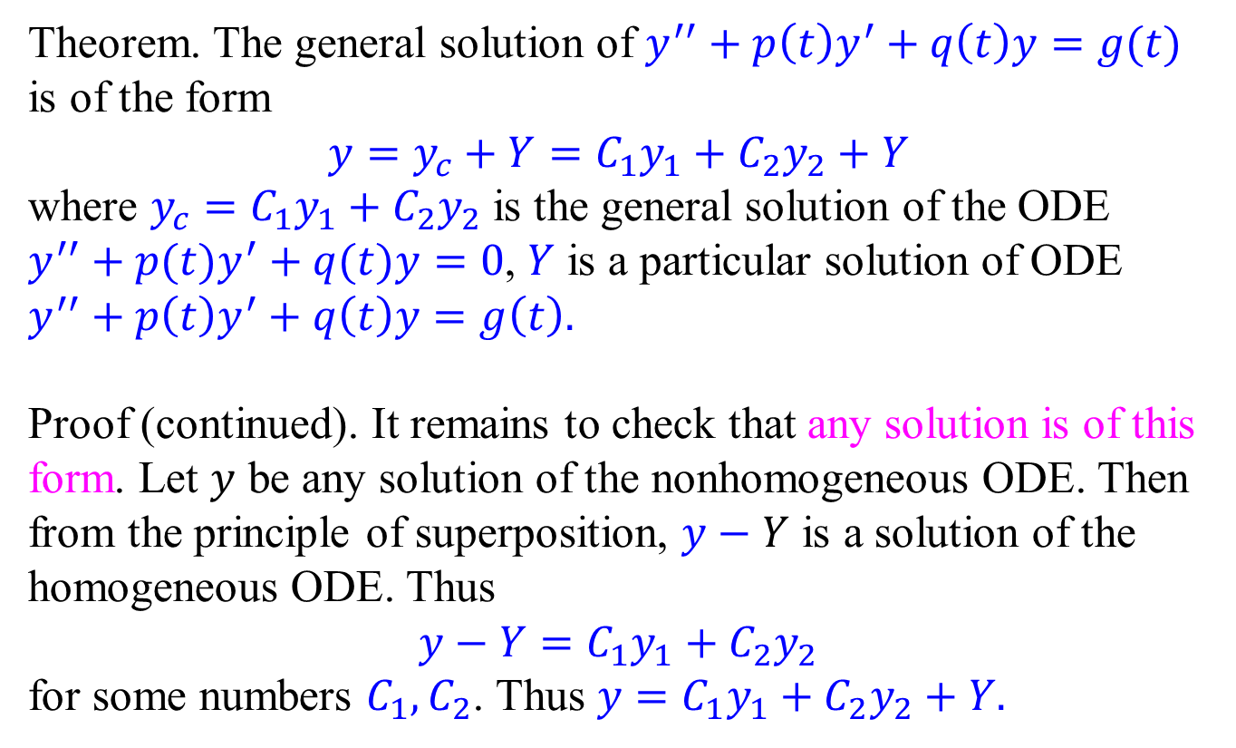
Structure theorem of the general solution
Theorem. The general solution of $y^{′′}+p\left(t\right)y^{′}+q\left(t\right)y=g(t)$ is of the form $$y=y_{c}+Y=C_{1}y_{1}+C_{2}y_{2}+Y$$
where $y_{c}=C_{1}y_{1}+C_{2}y_{2}$ is the general solution of the ODE $y^{′′}+p(t)y^{′}+q(t)y=0$, $Y$ is a particular solution of ODE $y^{′′}+p\left(t\right)y^{′}+q\left(t\right)y=g\left(t\right).$
Proof (continued). It remains to check that any solution is of this form. Let $y$ be any solution of the nonhomogeneous ODE. Then from the principle of superposition, $y−Y$ is a solution of the homogeneous ODE. Thus $$y−Y=C_{1}y_{1}+C_{2}y_{2}$$
for some numbers $C_{1}, C_{2}$. Thus $y=C_{1}y_{1}+C_{2}y_{2}+Y.$

Slide 11
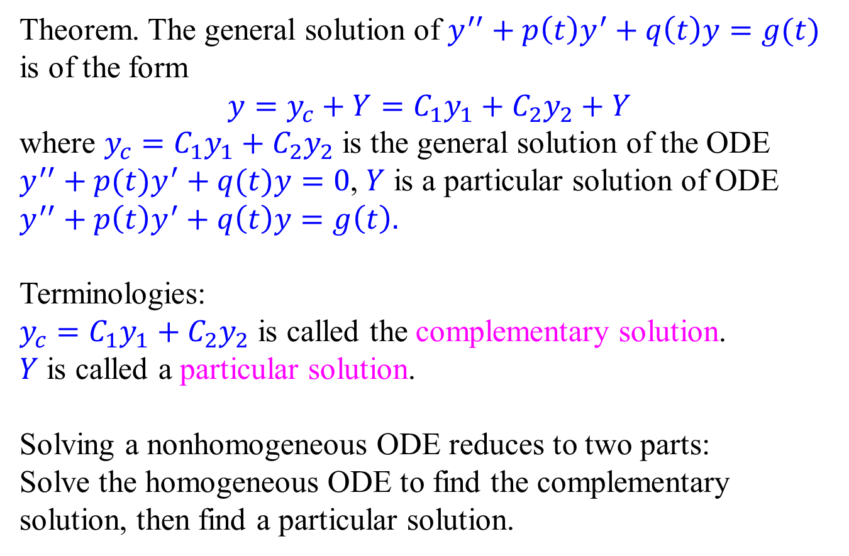
Structure theorem of the general solution
Theorem. The general solution of $y^{′′}+p\left(t\right)y^{′}+q\left(t\right)y=g(t)$ is of the form $$y=y_{c}+Y=C_{1}y_{1}+C_{2}y_{2}+Y$$
where $y_{c}=C_{1}y_{1}+C_{2}y_{2}$ is the general solution of the ODE $y^{′′}+p(t)y^{′}+q(t)y=0$, $Y$ is a particular solution of ODE $y^{′′}+p\left(t\right)y^{′}+q\left(t\right)y=g\left(t\right).$
Terminologies:
$y_{c}=C_{1}y_{1}+C_{2}y_{2}$ is called the complementary solution.
$Y$ is called a particular solution.
Solving a nonhomogeneous ODE reduces to two parts: Solve the homogeneous ODE to find the complementary solution, then find a particular solution.

Slide 12
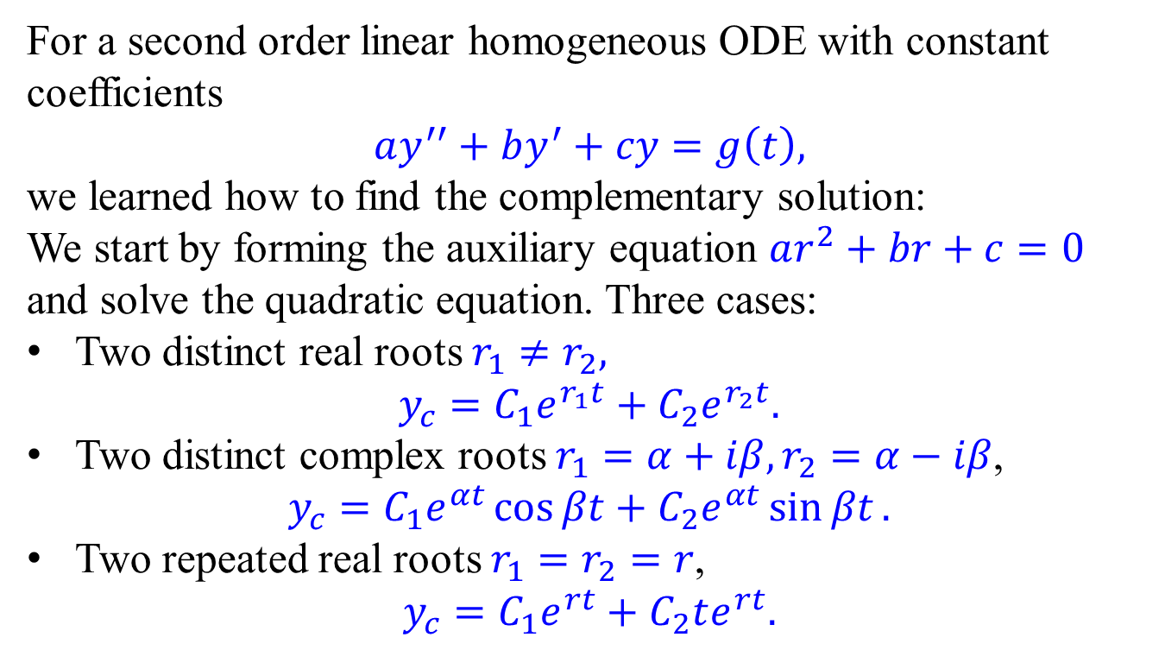
Linear ODE with constant coefficients
For a second order linear homogeneous ODE with constant coefficients
$$ay^{′′}+by^{′}+cy=g\left(t\right),$$
we learned how to find the complementary solution:
We start by forming the auxiliary equation $ar^{2}+br+c=0$ and solve the quadratic equation. Three cases:
Two distinct real roots $r_{1}≠r_{2},$
$$y_{c}=C_{1}e^{r_{1}t}+C_{2}e^{r_{2}t}.$$
Two distinct complex roots $r_{1}=α+iβ, r_{2}=α−iβ$, $y_{c}=C_{1}e^{αt}\cos{βt}+C_{2}e^{αt}\sin{βt}.$
Two repeated real roots $r_{1}=r_{2}=r$,
$$y_{c}=C_{1}e^{rt}+C_{2}te^{rt}.$$

Slide 13
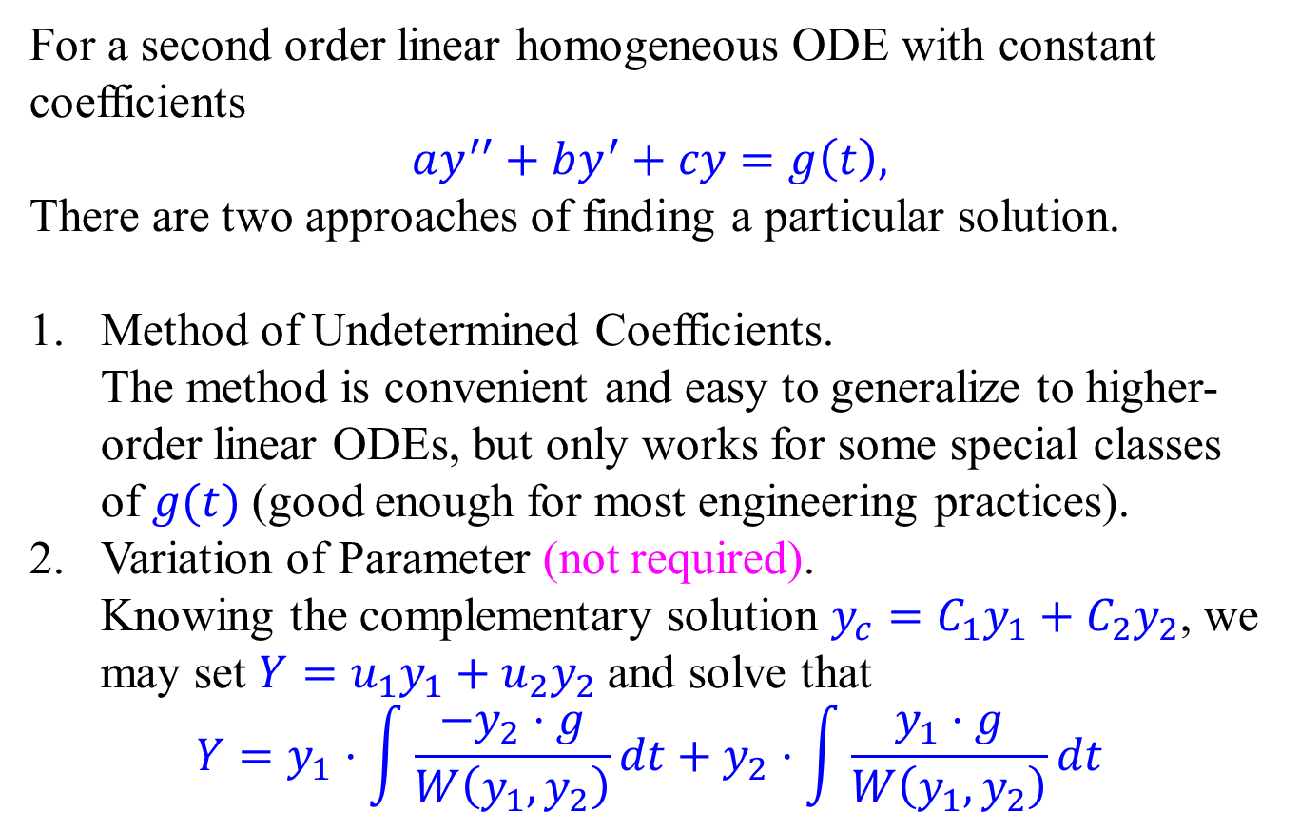
Linear ODE with constant coefficients
For a second order linear homogeneous ODE with constant coefficients
$$ay^{′′}+by^{′}+cy=g\left(t\right),$$
There are two approaches of finding a particular solution.
Method of Undetermined Coefficients. The method is convenient and easy to generalize to higher-order linear ODEs, but only works for some special classes of $g(t)$ (good enough for most engineering practices).
Variation of Parameter (not required). Knowing the complementary solution $y_{c}=C_{1}y_{1}+C_{2}y_{2}$, we may set $Y=u_{1}y_{1}+u_{2}y_{2}$ and solve that
$$Y=y_{1}⋅\int{\frac{−y_{2}⋅g}{W\left(y_{1},y_{2}\right)}dt}+y_{2}⋅\int{\frac{y_{1}⋅g}{W\left(y_{1},y_{2}\right)}dt}$$

Slide 14
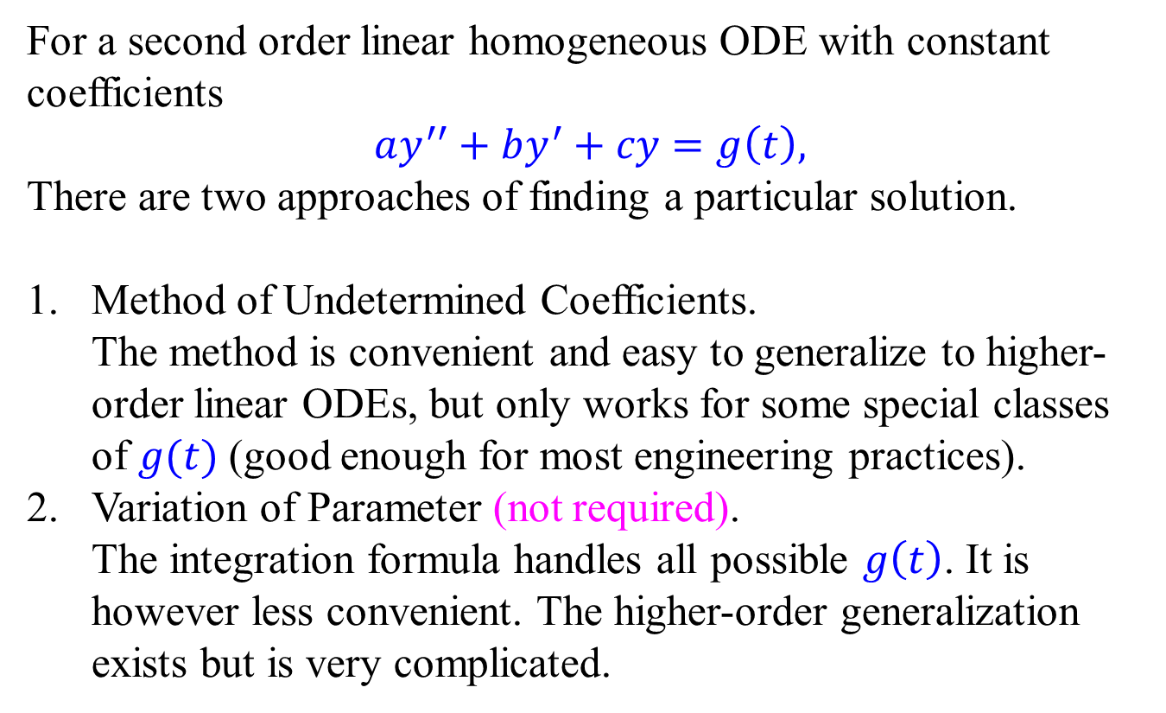
Linear ODE with constant coefficients
For a second order linear homogeneous ODE with constant coefficients
$$ay^{′′}+by^{′}+cy=g\left(t\right),$$
There are two approaches of finding a particular solution.
Method of Undetermined Coefficients. The method is convenient and easy to generalize to higher-order linear ODEs, but only works for some special classes of $g(t)$ (good enough for most engineering practices).
Variation of Parameter (not required). The integration formula handles all possible $g\left(t\right)$. It is however less convenient. The higher-order generalization exists but is very complicated.

Slide 15
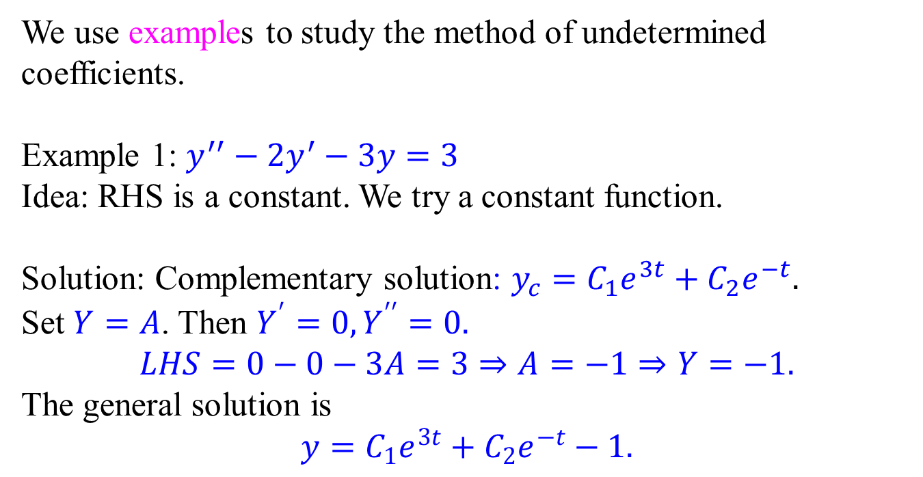
Method of Undetermined Coefficients
We use examples to study the method of undetermined coefficients.
Example 1: $y^{′′}−2y^{′}−3y=3$
Idea: RHS is a constant. We try a constant function.
Solution: Complementary solution: $y_{c}=C_{1}e^{3t}+C_{2}e^{−t}.$
Set $Y=A$. Then $Y^{′}=0,Y^{′′}=0.$
$$LHS=0−0−3A=3⇒A=−1⇒Y=−1.$$
The general solution is
$$y=C_{1}e^{3t}+C_{2}e^{−t}−1.$$

Slide 16
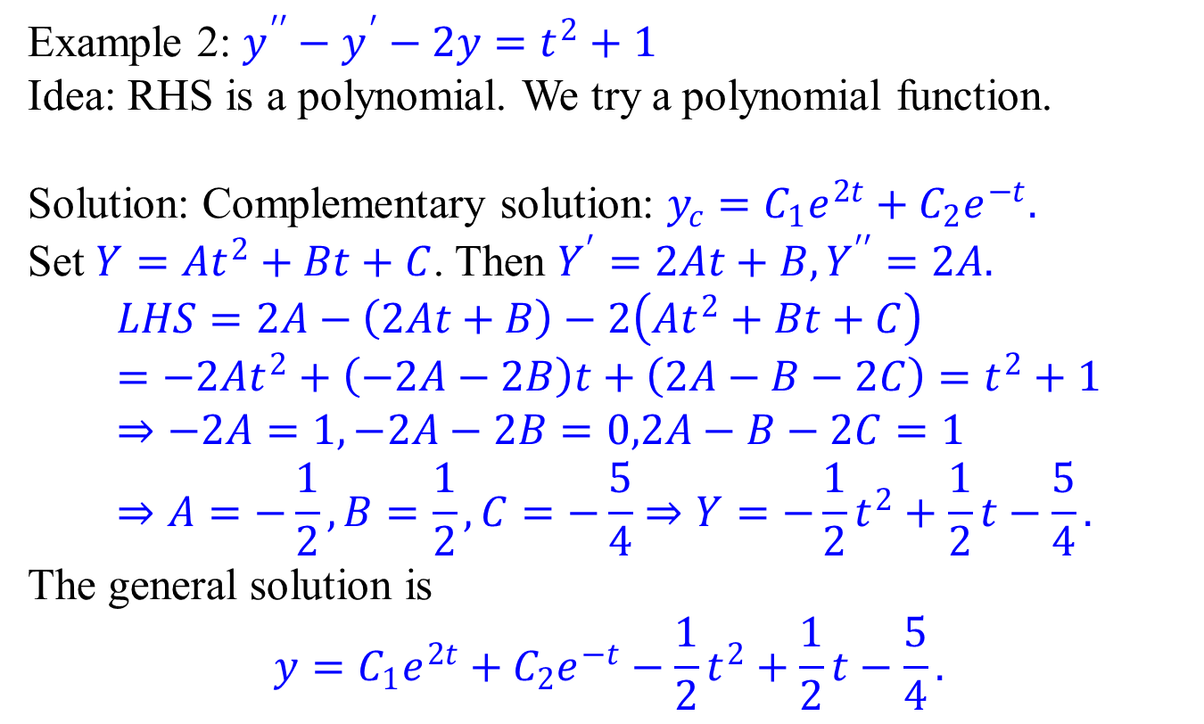
Method of Undetermined Coefficients
Example 2: $y^{′′}−y^{′}−2y=t^{2}+1$
Idea: RHS is a polynomial. We try a polynomial function.
Solution: Complementary solution: $y_{c}=C_{1}e^{2t}+C_{2}e^{−t}.$
Set $Y=At^{2}+Bt+C$. Then $Y^{′}=2At+B,Y^{′′}=2A.$
$$LHS=2A−\left(2At+B\right)−2\left(At^{2}+Bt+C\right) \\ =−2At^{2}+\left(−2A−2B\right)t+\left(2A−B−2C\right)=t^{2}+1 \\ ⇒−2A=1,−2A−2B=0,2A−B−2C=1 \\ ⇒A=−\frac{1}{2},B=\frac{1}{2},C=−\frac{5}{4}⇒Y=−\frac{1}{2}t^{2}+\frac{1}{2}t−\frac{5}{4}.$$
The general solution is
$$y=C_{1}e^{2t}+C_{2}e^{−t}−\frac{1}{2}t^{2}+\frac{1}{2}t−\frac{5}{4}.$$

Slide 17
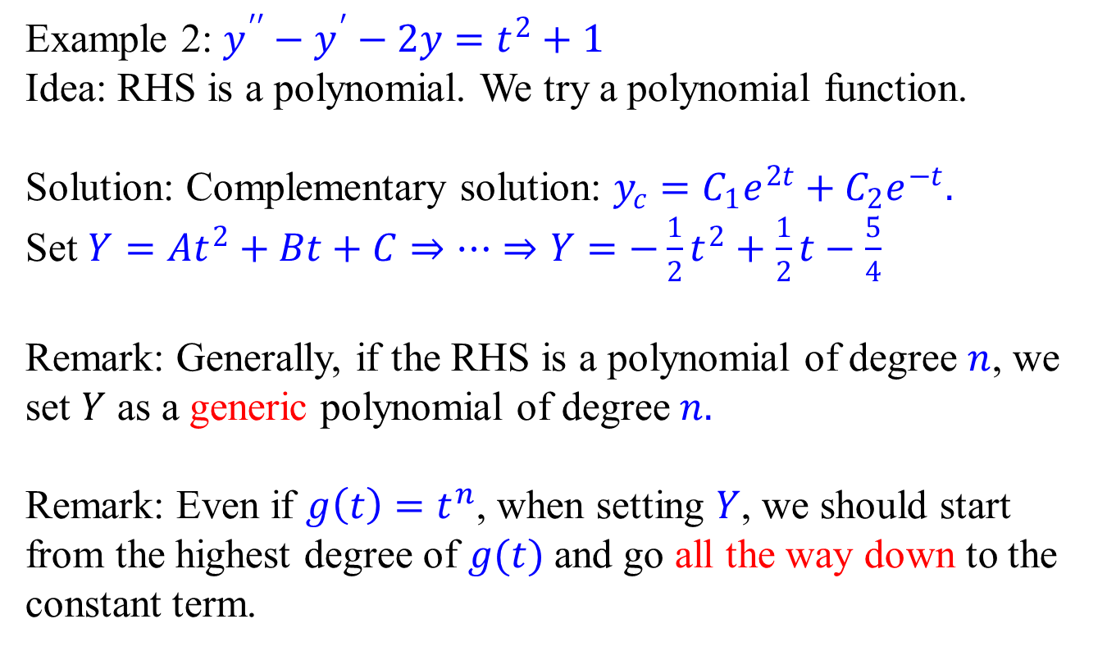
Method of Undetermined Coefficients
Example 2: $y^{′′}−y^{′}−2y=t^{2}+1$
Idea: RHS is a polynomial. We try a polynomial function.
Solution: Complementary solution: $y_{c}=C_{1}e^{2t}+C_{2}e^{−t}.$
Set $Y=At^{2}+Bt+C⇒⋯⇒Y=−\frac{1}{2}t^{2}+\frac{1}{2}t−\frac{5}{4}$
Remark: Generally, if the RHS is a polynomial of degree $n$, we set $Y$ as a generic polynomial of degree$n.$
Remark: Even if $g\left(t\right)=t^{n}$, when setting $Y$, we should start from the highest degree of $g(t)$ and go all the way down to the constant term.

Slide 18
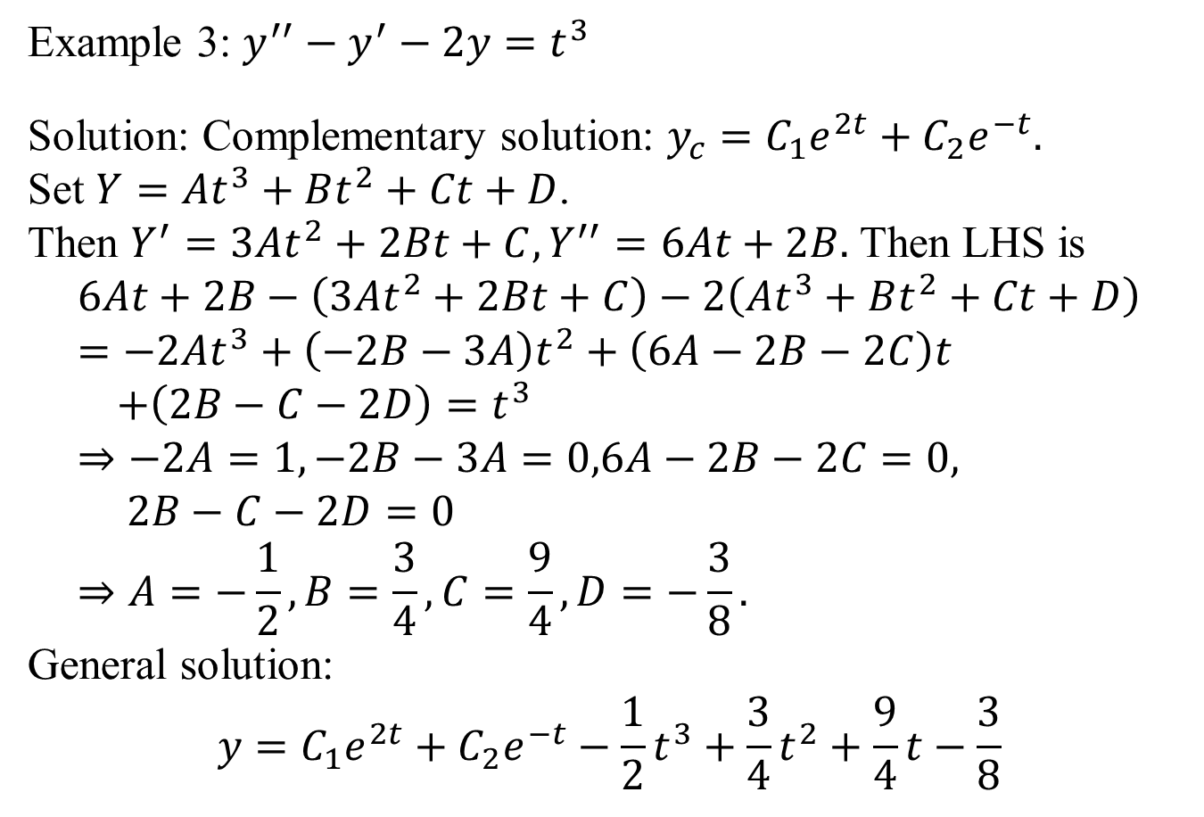
Method of Undetermined Coefficients
Example 3: $y^{′′}−y^{′}−2y=t^{3}$
Solution: Complementary solution: $y_{c}=C_{1}e^{2t}+C_{2}e^{−t}.$
Set $Y=At^{3}+Bt^{2}+Ct+D$.
Then $Y^{′}=3At^{2}+2Bt+C, Y^{′′}=6At+2B.$ Then LHS is
$$6At+2B−\left(3At^{2}+2Bt+C\right)−2\left(At^{3}+Bt^{2}+Ct+D\right) \\ =−2At^{3}+\left(−2B−3A\right)t^{2}+\left(6A−2B−2C\right)t \\ +\left(2B−C−2D\right)=t^{3} \\ ⇒−2A=1,−2B−3A=0,6A−2B−2C=0, \\ 2B−C−2D=0 \\ ⇒A=−\frac{1}{2}, B=\frac{3}{4},C=\frac{9}{4},D=−\frac{3}{8}.$$
General solution:
$$y=C_{1}e^{2t}+C_{2}e^{−t}−\frac{1}{2}t^{3}+\frac{3}{4}t^{2}+\frac{9}{4}t−\frac{3}{8}$$

Slide 19
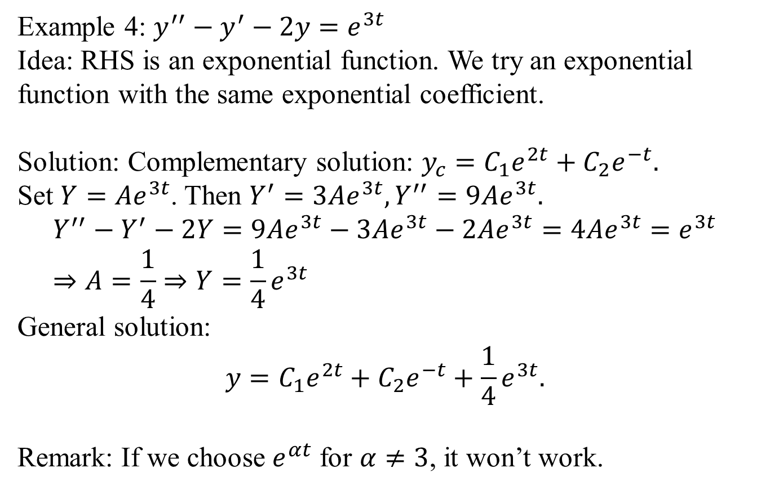
Method of Undetermined Coefficients
Example 4: $y^{′′}−y^{′}−2y=e^{3t}$
Idea: RHS is an exponential function. We try an exponential function with the same exponential coefficient.
Solution: Complementary solution: $y_{c}=C_{1}e^{2t}+C_{2}e^{−t}.$
Set $Y=Ae^{3t}$. Then $Y^{′}=3Ae^{3t}, Y^{′′}=9Ae^{3t}.$ $$Y^{′′}−Y^{′}−2Y=9Ae^{3t}−3Ae^{3t}−2Ae^{3t}=4Ae^{3t}=e^{3t} \\ ⇒A=\frac{1}{4}⇒Y=\frac{1}{4}e^{3t}$$
General solution:
$$y=C_{1}e^{2t}+C_{2}e^{−t}+\frac{1}{4}e^{3t}.$$
Remark: If we choose $e^{αt}$ for $α≠3$, it won’t work.

Slide 20
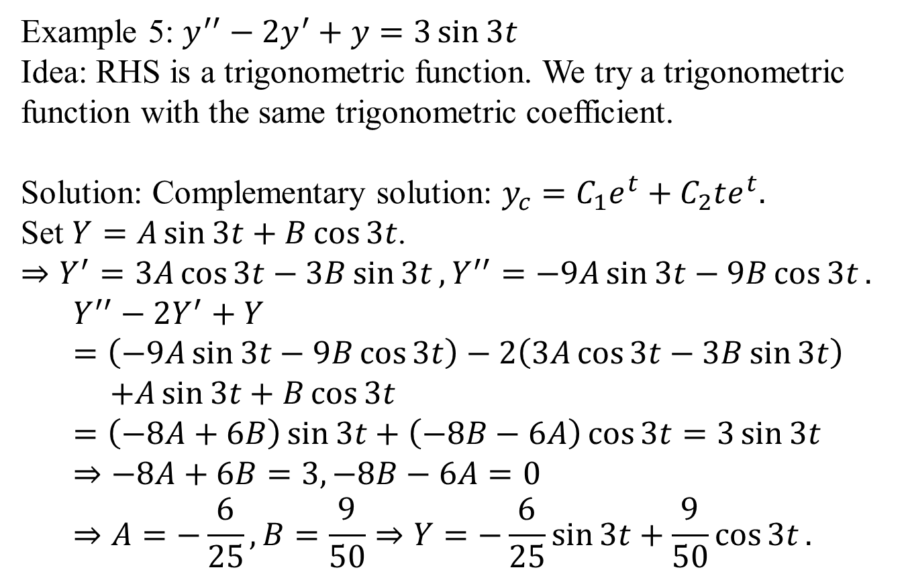
Method of Undetermined Coefficients
Example 5: $y^{′′}−{2y}^{′}+y=3\sin{3t}$
Idea: RHS is a trigonometric function. We try a trigonometric function with the same trigonometric coefficient.
Solution: Complementary solution: $y_{c}=C_{1}e^{t}+C_{2}te^{t}.$
Set $Y=A\sin{3t}+B\cos{3t}$.
$⇒Y^{′}=3A\cos{3t}−3B\sin{3t}, Y^{′′}=−9A\sin{3t}−9B\cos{3t}.$
$$Y^{′′}−2Y^{′}+Y=\left(−9A\sin{3t}−9B\cos{3t}\right)−2\left(3A\cos{3t}−3B\sin{3t}\right) \\ +A\sin{3t}+B\cos{3t} \\ =\left(−8A+6B\right)\sin{3t}+\left(−8B−6A\right)\cos{3t}=3\sin{3t} \\ ⇒−8A+6B=3,−8B−6A=0 \\ ⇒A=−\frac{6}{25},B=\frac{9}{50}⇒Y=−\frac{6}{25}\sin{3t}+\frac{9}{50}\cos{3t}.$$
Note that both sin and cos should appear.

Slide 21
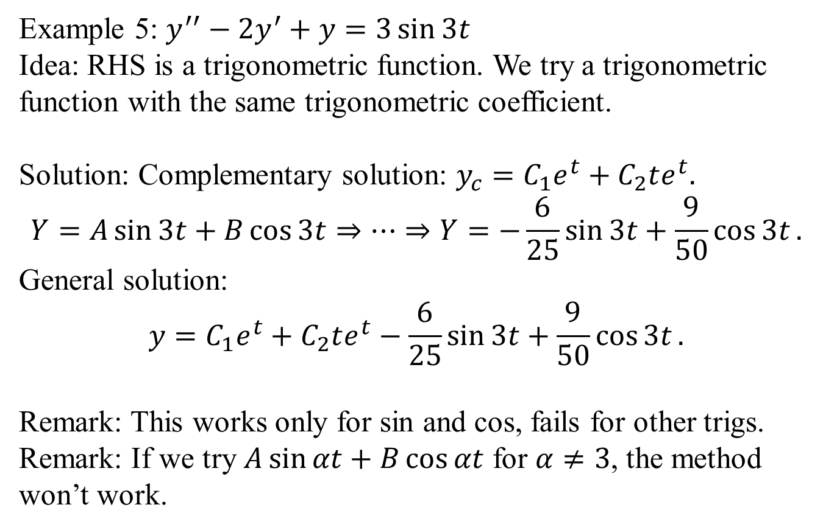
Method of Undetermined Coefficients
Example 5: $y^{′′}−{2y}^{′}+y=3\sin{3t}$
Idea: RHS is a trigonometric function. We try a trigonometric function with the same trigonometric coefficient.
Solution: Complementary solution: $y_{c}=C_{1}e^{t}+C_{2}te^{t}.$
$$Y=A\sin{3t}+B\cos{3t}⇒⋯⇒Y=−\frac{6}{25}\sin{3t}+\frac{9}{50}\cos{3t}.$$
General solution:
$$y=C_{1}e^{t}+C_{2}te^{t}−\frac{6}{25}\sin{3t}+\frac{9}{50}\cos{3t}.$$
Remark: This works only for sin and cos, fails for other trigs.
Remark: If we try $A\sin{αt}+B\cos{αt}$ for $α≠3$, the method won’t work.

Slide 22
Important Conceptual Remarks
The method works because
Derivatives of polynomial functions are polynomials (up to the same degree).
Derivatives of exponential functions are exponential functions (with the same exponential coefficient).
Derivatives of sine and cosine functions are sine and cosine functions (with the same trigonometric coefficient).
For functions without this property, the method fails. You will have to use the integration formula.
The polynomials, exponentials, sine and cosine functions are referred as the basic types. Observe that products of basic type functions satisfy the same property.

Slide 23
Important Conceptual Remarks
The method works because
Derivatives of polynomial functions are polynomials (up to the same degree).
Derivatives of exponential functions are exponential functions (with the same exponential coefficient).
Derivatives of sine and cosine functions are sine and cosine functions (with the same trigonometric coefficient).
For functions without this property, the method fails. You will have to use the integration formula.
The polynomials, exponentials, sine and cosine functions are referred as the basic types. Observe that products of basic type functions satisfy the same property.

Slide 24
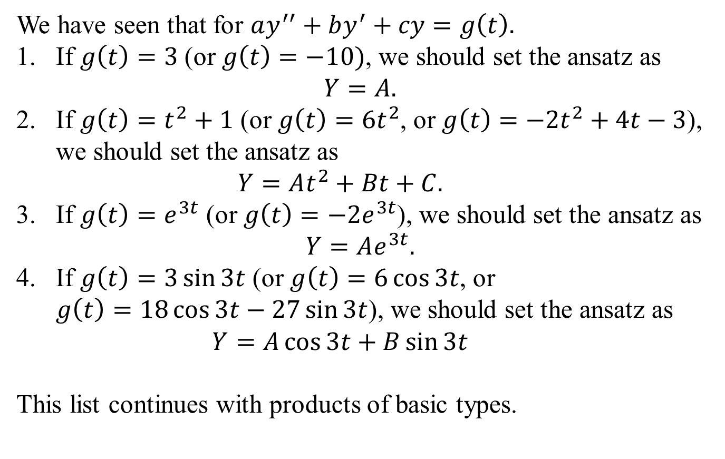
Method of Undetermined Coefficients
We have seen that for $ay^{′′}+by^{′}+cy=g\left(t\right).$
If $g\left(t\right)=3$ (or $g\left(t\right)=−10)$, we should set the ansatz as $Y=A.$
If $g\left(t\right)=t^{2}+1$ (or $g\left(t\right)=6t^{2}$, or $g\left(t\right)=−2t^{2}+4t−3$), we should set the ansatz as $Y=At^{2}+Bt+C.$
If $g\left(t\right)=e^{3t}$ (or $g\left(t\right)=−2e^{3t}$), we should set the ansatz as
$$Y=Ae^{3t}.$$
If $g\left(t\right)=3\sin{3t}$ (or $g\left(t\right)=6\cos{3t}$, or $g\left(t\right)=18\cos{3t}−27\sin{3t}$), we should set the ansatz as $Y=A\cos{3t}+B\sin{3t}$
This list continues with products of basic types.

Slide 25
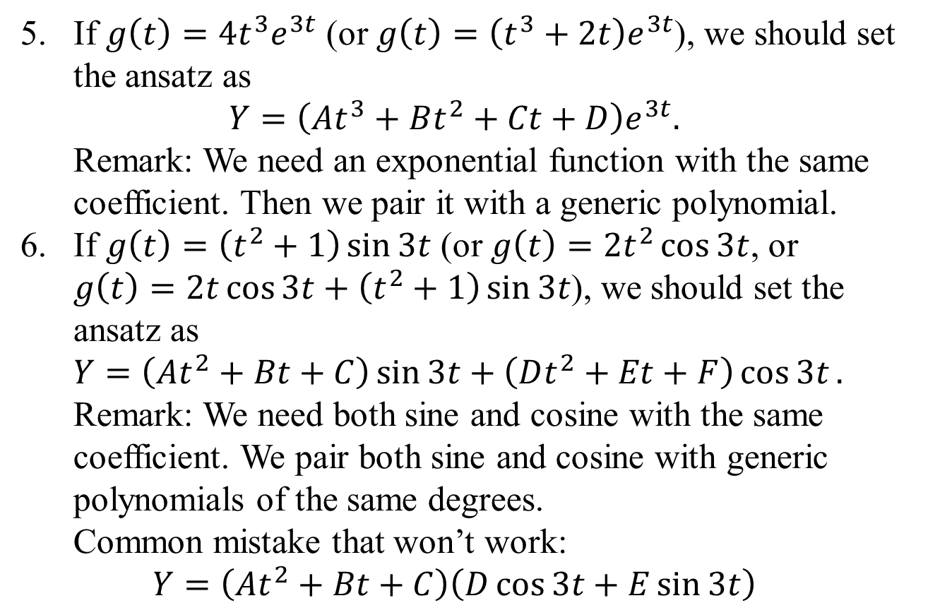
Method of Undetermined Coefficients
If $g\left(t\right)=4t^{3}e^{3t}$ (or $g\left(t\right)=\left(t^{3}+2t\right)e^{3t}$), we should set the ansatz as $Y=\left(At^{3}+Bt^{2}+Ct+D\right)e^{3t}.$ Remark: We need an exponential function with the same coefficient. Then we pair it with a generic polynomial.
If $g\left(t\right)=\left(t^{2}+1\right)\sin{3t}$ (or $g\left(t\right)=2t^{2}\cos{3t}$, or $g\left(t\right)=2t\cos{3t}+\left(t^{2}+1\right)\sin{3t}$), we should set the ansatz as $Y=\left(At^{2}+Bt+C\right)\sin{3t}+\left(Dt^{2}+Et+F\right)\cos{3t}.$ Remark: We need both sine and cosine with the same coefficient. We pair both sine and cosine with generic polynomials of the same degrees. Common mistake that won’t work: $Y=\left(At^{2}+Bt+C\right)\left(D\cos{3t}+E\sin{3t}\right)$

Slide 26
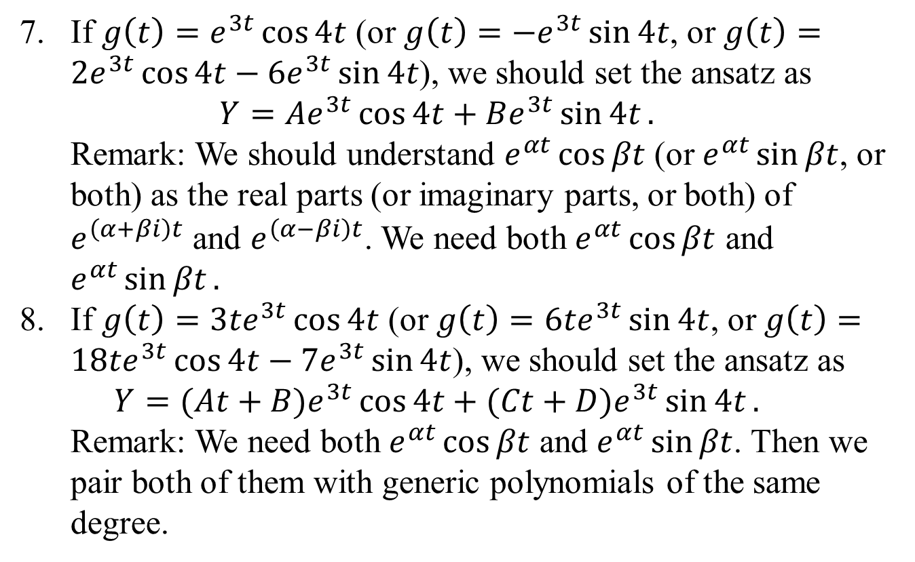
Method of Undetermined Coefficients
If $g\left(t\right)=e^{3t}\cos{4t}$ (or $g\left(t\right)=−e^{3t}\sin{4t}$, or $g\left(t\right)=2e^{3t}\cos{4t}−6e^{3t}\sin{4t}$), we should set the ansatz as $Y=Ae^{3t}\cos{4t}+Be^{3t}\sin{4t}.$ Remark: We should understand $e^{αt}\cos{βt}$ (or $e^{αt}\sin{βt}$, or both) as the real parts (or imaginary parts, or both) of $e^{\left(α+βi\right)t}$ and $e^{\left(α−βi\right)t}$. We need both $e^{αt}\cos{βt}$ and $e^{αt}\sin{βt}.$
If $g\left(t\right)={3te}^{3t}\cos{4t}$ (or $g\left(t\right)=6te^{3t}\sin{4t}$, or $g\left(t\right)=18te^{3t}\cos{4t}−7e^{3t}\sin{4t}$), we should set the ansatz as $Y=(At+B)e^{3t}\cos{4t}+(Ct+D)e^{3t}\sin{4t}.$ Remark: We need both $e^{αt}\cos{βt}$ and $e^{αt}\sin{βt}$. Then we pair both of them with generic polynomials of the same degree.

Slide 27
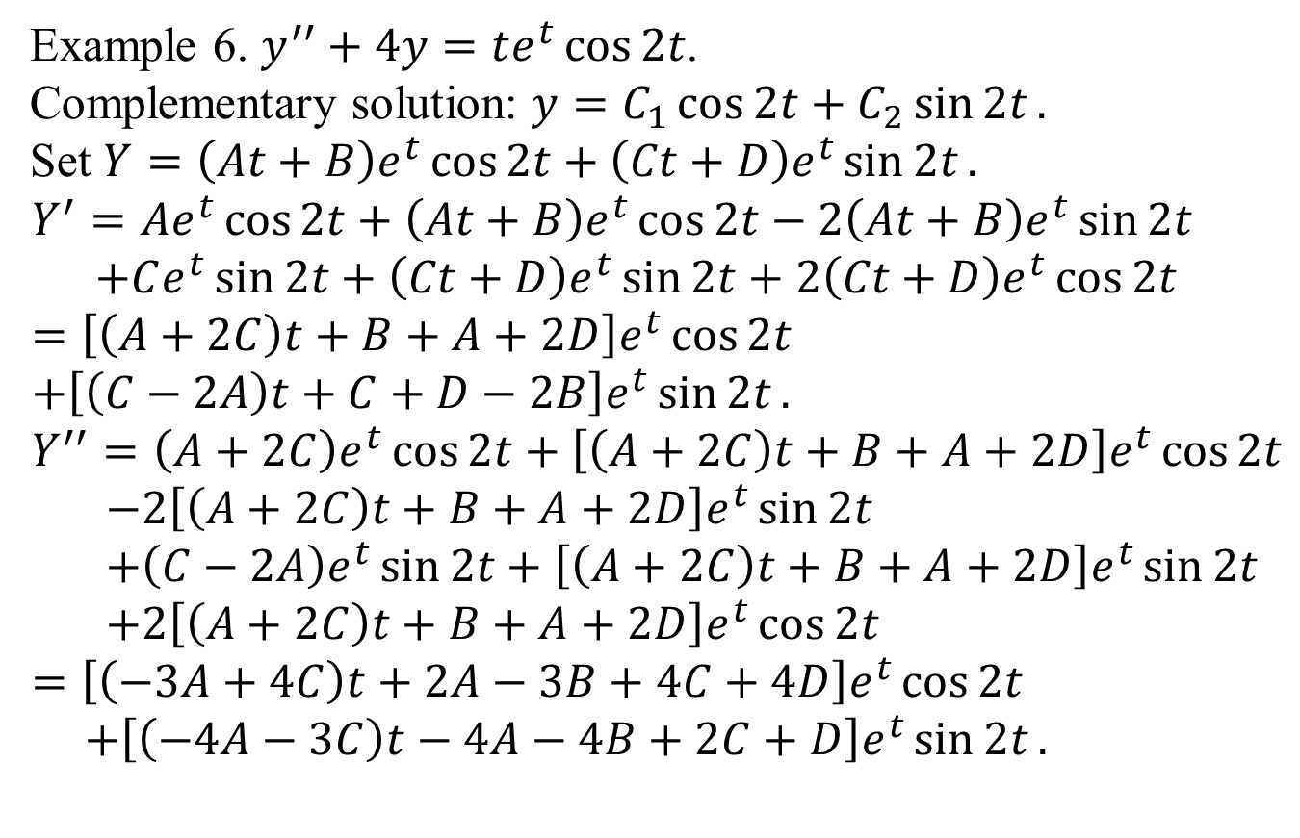
Method of Undetermined Coefficients
Example 6. $y^{′′}+4y=te^{t}\cos{2t}$.
Complementary solution: $y=C_{1}\cos{2t}+C_{2}\sin{2t}.$
Set $Y=\left(At+B\right)e^{t}\cos{2t}+\left(Ct+D\right)e^{t}\sin{2t}.$
$$Y^{′}=Ae^{t}\cos{2t}+\left(At+B\right)e^{t}\cos{2t}−2\left(At+B\right)e^{t}\sin{2t} \\ +Ce^{t}\sin{2t}+\left(Ct+D\right)e^{t}\sin{2t}+2\left(Ct+D\right)e^{t}\cos{2t} \\ =\left[\left(A+2C\right)t+B+A+2D\right]e^{t}\cos{2t} \\ +\left[\left(C−2A\right)t+C+D−2B\right]e^{t}\sin{2t}. \\ Y^{′′}=\left(A+2C\right)e^{t}\cos{2t}+\left[\left(A+2C\right)t+B+A+2D\right]e^{t}\cos{2t} \\ −2\left[\left(A+2C\right)t+B+A+2D\right]e^{t}\sin{2t} \\ +\left(C−2A\right)e^{t}\sin{2t}+\left[\left(A+2C\right)t+B+A+2D\right]e^{t}\sin{2t} \\ +2\left[\left(A+2C\right)t+B+A+2D\right]e^{t}\cos{2t} \\ =\left[\left(−3A+4C\right)t+2A−3B+4C+4D\right]e^{t}\cos{2t} \\ +\left[\left(−4A−3C\right)t−4A−4B+2C+D\right]e^{t}\sin{2t}.$$

Slide 28
Method of Undetermined Coefficients
Example 6. $y^{′′}+4y=te^{t}\cos{2t}$.
Complementary solution: $y=C_{1}\cos{2t}+C_{2}\sin{2t}.$
Set $Y=\left(At+B\right)e^{t}\cos{2t}+\left(Ct+D\right)e^{t}\sin{2t}.$
$$Y^{′}=Ae^{t}\cos{2t}+\left(At+B\right)e^{t}\cos{2t}−2\left(At+B\right)e^{t}\sin{2t} \\ +Ce^{t}\sin{2t}+\left(Ct+D\right)e^{t}\sin{2t}+2\left(Ct+D\right)e^{t}\cos{2t} \\ =\left[\left(A+2C\right)t+B+A+2D\right]e^{t}\cos{2t} \\ +\left[\left(C−2A\right)t+C+D−2B\right]e^{t}\sin{2t}. \\ Y^{′′}=\left(A+2C\right)e^{t}\cos{2t}+\left[\left(A+2C\right)t+B+A+2D\right]e^{t}\cos{2t} \\ −2\left[\left(A+2C\right)t+B+A+2D\right]e^{t}\sin{2t} \\ +\left(C−2A\right)e^{t}\sin{2t}+\left[\left(A+2C\right)t+B+A+2D\right]e^{t}\sin{2t} \\ +2\left[\left(A+2C\right)t+B+A+2D\right]e^{t}\cos{2t} \\ =\left[\left(−3A+4C\right)t+2A−3B+4C+4D\right]e^{t}\cos{2t} \\ +\left[\left(−4A−3C\right)t−4A−4B+2C+D\right]e^{t}\sin{2t}.$$

Slide 29
Method of Undetermined Coefficients

